Slide 1

Rome Feed Processing

Slide 2
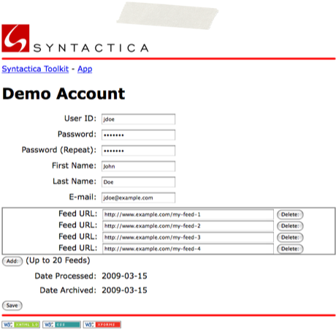

RSS/Atom Demo
Create the demo account
place each feed URL into the processing queue
Once all feed URLs are processed, then email user with link to the processed data

Slide 3

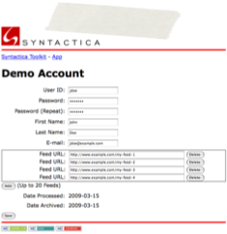
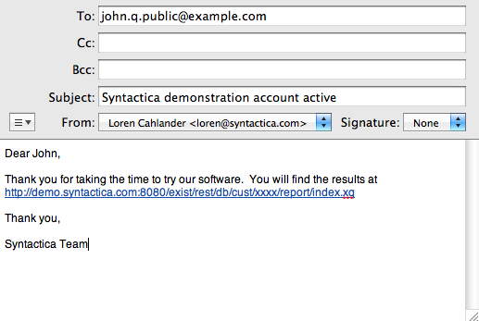
Queue Processing
RSS/Atom
RSS/Atom
RSS/Atom
RSS/Atom
RSS/Atom
eXist Job Process
FeedProcessor
FeedProcessor
FeedProcessor
EntryProcessor
EntryProcessor
EntryProcessor

Slide 5

Feed Processing
Feed process array of size N threads
Array size can be changed through an mbean
When the feed process is invoked, the array is scanned for empty or completed slots
If an available slot is found then the first RSS in the queue is added as a new FeedProcessor thread

Slide 6
FeedProcessor
Use Rome processing code to get the feed header and the list of entries
Each entry is processed through the threaded Entry process.
Once all entries are processed, then the FeedProcessor thread is terminated.

Slide 7
Entry Processing
Entry process array of size N threads
Array size can be changed through an mbean
The list of entries is processed by scanning the array for empty or completed slots
If an available slot is found then the entry is added as a new EntryProcessor thread

Slide 8
EntryProcessor
Add SyndFeed data to root
Add SyndEntry data to root
Get filtered text from entry server and get UIMA annotations
Get abstract from Syntactica server
Get weighted abstract from Syntactica server
Get weighted subject from Syntactica server
Store in eXist datastore
SyndFeed
SyndEntry
Sofas
Text
Abstract
WAbstract
WSubject

Slide 9


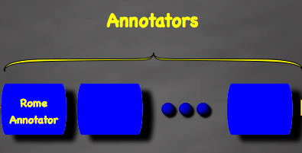
EntryProcessor
Entry URL
Sofas
Text
Abstract
WAbstract
demo.syntactica.com/parts-of-speech
WSubject
Abstract
Weighted Abstract
Weighted Subject
ws.syntactica.com

